Slide 1
UADB: Unsupervised Anomaly Detection Booster
Alishba Ghazanfar

Slide 2
Table of Content
Introduction
Problem statement
Objectives
Booster Model
Methodology
Experimental Results
Conclusion
Proposed Solution

Slide 3
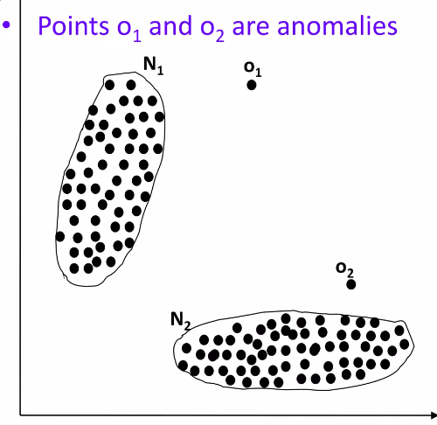
Introduction
- Unsupervised Anomaly Detection (UAD) is crucial due to its wide range of applications.
- Anomaly is a pattern in the data that does not confirm to the expected behavior.
- Real-world data complexity means no single assumption is universally applicable.
- Detection of anomalies have recently gained a lot of attention in many security domains.

Slide 4
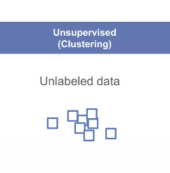
Unsupervised Anomaly Detection
- A key data mining problem due to its wide range of real-world applications.
- Absence of supervision signals requires reliance on assumptions about anomalies:
- Scattered, sparsely clustered, or densely clustered patterns.
- Real-world data complexity varies significantly across domains.
- No single assumption fits all datasets.
- Recent research shows no UAD method is omnipotent.

Slide 5
Problem Statement
- Traditional UAD models rely on specific assumptions about anomalies.
- Assumptions vary significantly and don't apply to all datasets.
- Anomalies lack clear structure and are harder to learn without suitable assumptions.
- There's high variance between different anomaly detection models.

Slide 6
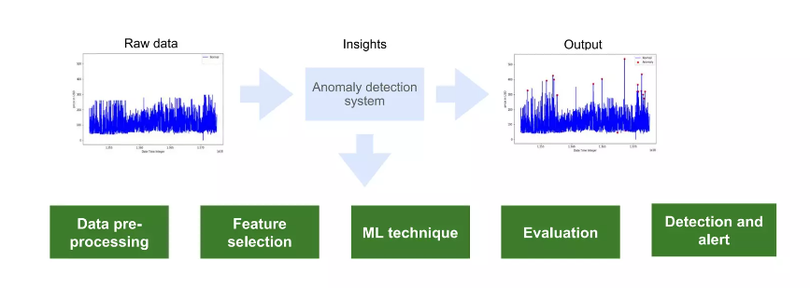
Proposed Solution
- Introduce a general UAD Booster (UADB) that empowers existing UAD models.
- Use a neural network as the booster due to its strong expressive power.
- A model-agnostic framework improves UAD models in a unified way:
- Distill knowledge from the original UAD model
- Exploit variance between models to correct assumptions

Slide 7
Proposed Solution
- Step 1: Distill the knowledge of the source UAD model to an imitation learner (booster):
- Train the booster model to imitate the original UAD model
- Step 2: Exploit the variance between the source model and the booster for automatic correction:
- Correct errors in the original UAD model using variance information
- Step 3: Improve the booster over the original UAD model:
- Refine the booster through iterative training

Slide 8
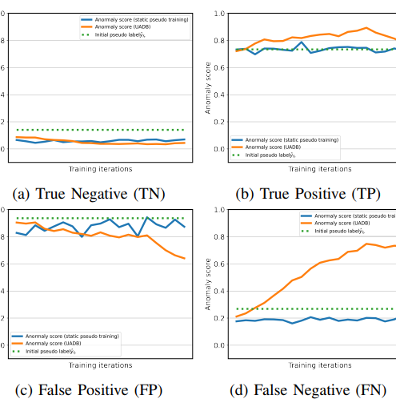
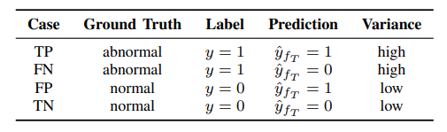
Variance for Error Correction
-Anomalies tend to exhibit higher prediction variance compared to normal data.
-Exploiting variance difference allows gradual correction of FP and FN errors.
Four types of instances in UAD:

Slide 9
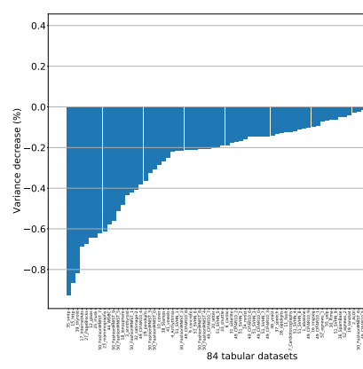
Methodology
Evaluate the booster model against existing UAD models:
- Compare performance with standard UAD models
Compare performance using standardized anomaly detection datasets:
- Utilize benchmark datasets for objective evaluation
Measure improvements in adaptability and detection accuracy:
- Quantify gains in detection accuracy over baseline models.

Slide 10
Experimental Results
UADB:
GPU: Training was performed on a Colab T4 GPU,
originally utilizing an NVIDIA Tesla V100
Training Cycle:
Epochs:10, Batch sizes: 256,
Learning rate: 0.001
DATASET | AUC ROC | AP
SMTP | 0.98 | 0.01
SHUTTLE | 0.96 | 0.83
LETTER | 0.60 | 0.08
SKIN | 0.70 | 0.50
CARDIO | 0.629 | 0.22

Slide 11
Our Implementations
1.UAD Model:
Implemented on 5 datasets.
1.SMTP
2.SHUTTLE
3.LETTER
4.SKIN
5.CARDIO
2.DNN Model:
Implemented on Heart Disease

Slide 12
DNN based Anomaly detection
1.PCA:PCA is used after standardization to reduce the dimensionality of the data.
2.Source Model:
The initial neural network trained on the original dataset.
Learns primary patterns and relationships in the data.
Establishes a baseline for performance.
3.Booster Model:
Enhances or refines predictions made by the source model.
Trained on pseudo-labels generated by the source model’s predictions.
Aims to correct errors and improve overall accuracy.

Slide 13
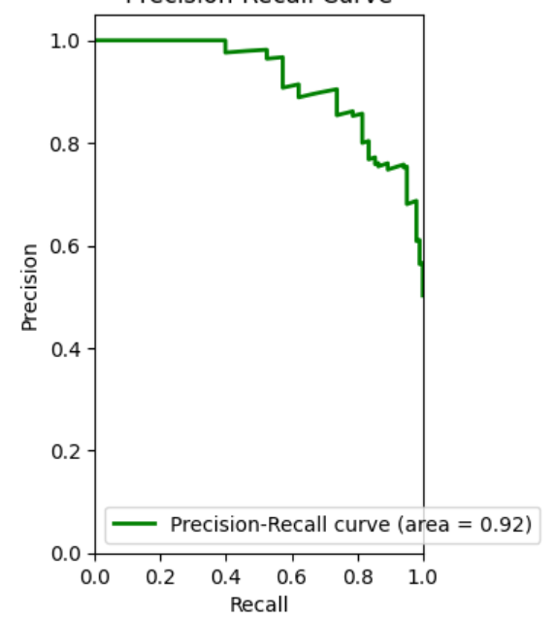
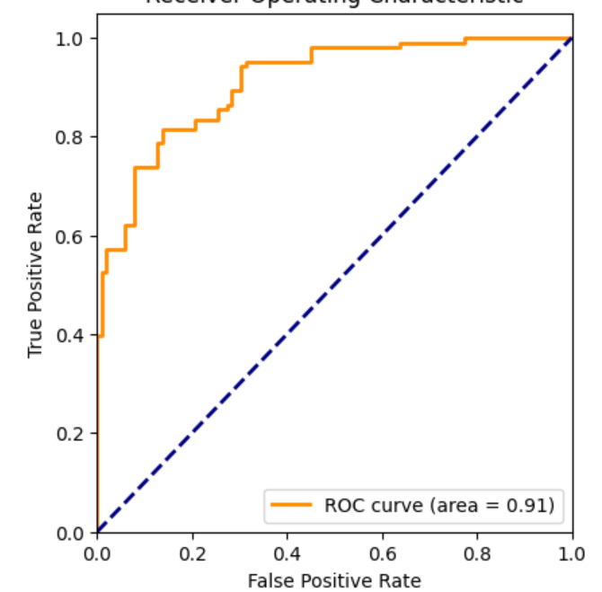
Results
.DNN Model:

Slide 14
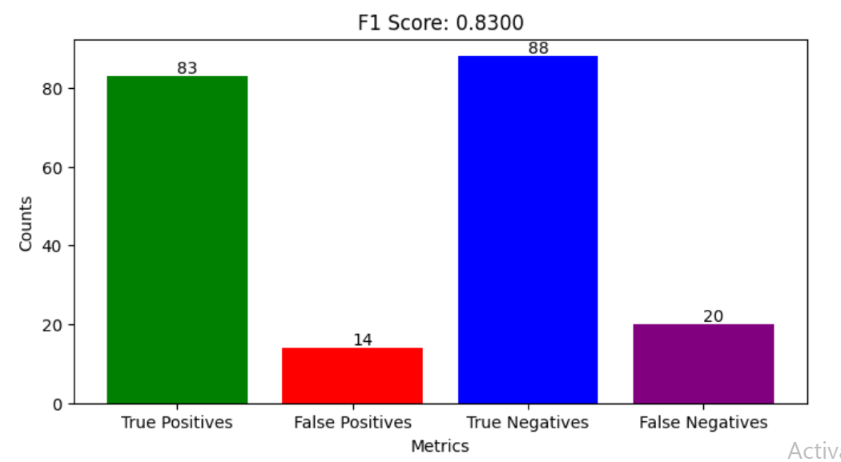
Results
.DNN Model:

Slide 15
DNN Model vs. UADB Model
DNN Architecture:
Feedforward Neural Network (Multilayer
Perceptron)
Layers: Input, Dense (ReLU), Batch-
Normalization,
Dropout, Output (Sigmoid)
Regularization: L2
Optimization: Adam optimizer
Key Techniques:
Standard scaling, early stopping, model
checkpointing
UAD Architecture:
Knowledge Distillation Framework
Components: Source UAD model, Booster model
Booster: Neural Network (Multilayer Perceptron)
Key Techniques: Knowledge distillation, variance estimation, adaptive error correction.

Slide 16
Results:
1.UAD Model:
GPU: Training was performed on a Colab T4 GPU,
originally utilizing an NVIDIA Tesla V100
Training Cycle:
Epochs:10, Batch sizes: 256,
Learning rate: 0.001
2.DNN Model:
GPU: Kaggle T4 * 2
Training Cycle:
Epochs:50, Batch sizes: 128,
Learning rate: 0.001
DATASET | AUC ROC | AP
SMTP | 0.98 | 0.01
SHUTTLE | 0.96 | 0.83
LETTER | 0.60 | 0.08
SKIN | 0.70 | 0.50
CARDIO | 0.629 | 0.22
DATASET | AUC ROC | AP
Heart Disease | 0.9195 | 0.9111

Slide 17
Conclusion
- This workflow of a robust method of using neural networks to predict anomaly outcomes. By employing PCA, the model efficiently handles high-dimensional data, potentially enhancing prediction accuracy and computational efficiency. The network’s architecture, with its regularization and normalization layers, is designed to optimize learning and generalization on unseen data.

Slide 18
Thank You

